Slide 1
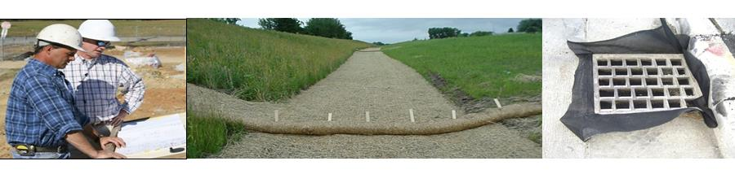

Clear, Consistent, & Predictable Rules
Unifying State and Local Soil Erosion and Sediment Control Standards for Better Outcomes
Eric Beck, P.E.
Supervisor, RIDEM RIPDES Permitting Program
Notes:
The Goal: Improve the implementation of SESC in State and Local permitting. Performance Criteria will ultimately apply to all construction sites in Rhode Island.
The Result: Consistent and Clear SESC Plan Requirements. Streamlined applications, No duplication of effort, Shared responsibility for compliance and enforcement, Training for plan reviewers and inspectors (3rd party certifications – licensing)

Slide 2
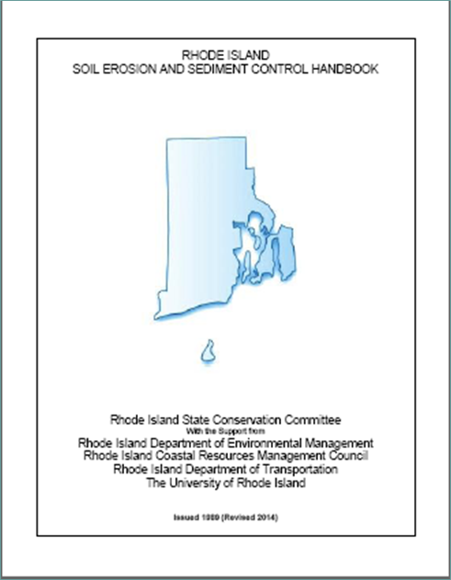

Slide 3
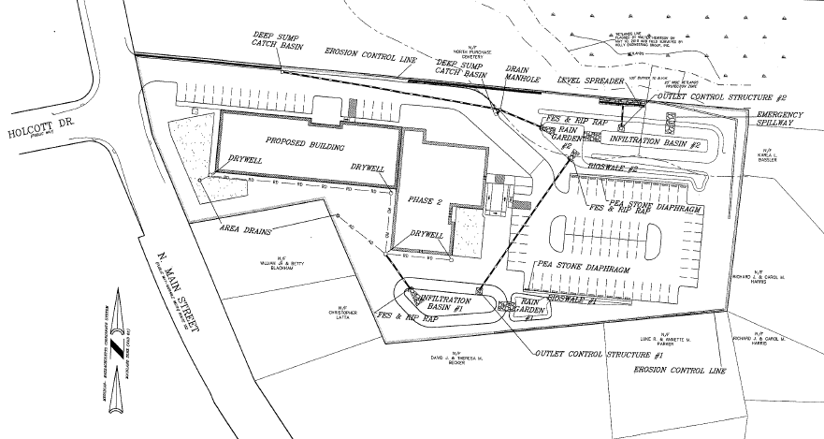
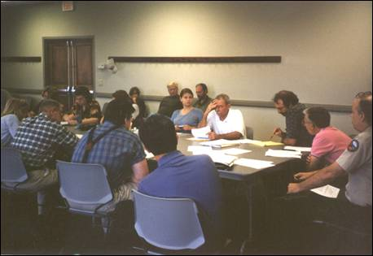

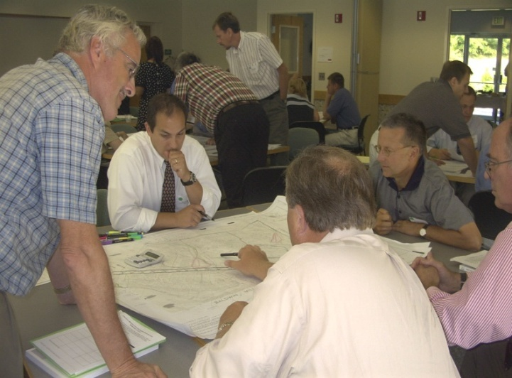
Who Should Use the Handbook?
Designers
Municipal Officials
Property Owners
Regulatory Reviewers

Slide 4
Enabling Legislation for State Regulations and Local Ordinances
Rhode Island General Law, Section 45, Chapter 61.2, entitled “The Smart Development for a Cleaner Bay Act of 2007” required DEM and CRMC to amend the 1993 Stormwater Design and Installation Standards Manual.
*RIGL 45-61.2-2(b) passed in the 2012 allows communities to adopt the stormwater manual as local requirements: ordinances may require compliance with the Rhode Island Stormwater Design and Installation Standards Manual for any development, redevelopment, or land disturbance.
In accordance with the RIPDES MS4 General Permit , Ms4s have adopted a local ordinances that references the RISDISM and RI SESC Handbook(as amended)

Slide 5
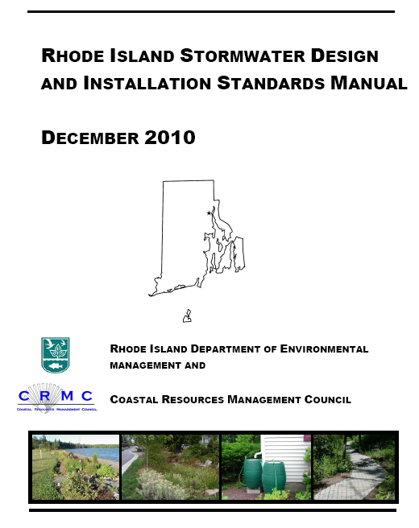
The Stormwater Manual Established Eleven (11) Stormwater Management Design Standards
1. LID Site Planning and Design
2. Groundwater Recharge
3. Water Quality
4. Conveyance and Channel Protection
5. Overbank Protection
6. Redevelopment Projects
7. Pollution Prevention
8. LUHPPLs
9. Illicit Discharges
10. Construction Activity Soil Erosion, Runoff, Sedimentation, and Pollution Prevention Control Measure Requirements
11. Operation and Maintenance

Slide 6
Stormwater Management Plan
Stormwater Site Planning, Analysis, and Design
(SW Manual)
Post Construction Operation and Maintenance
(SW Manual)
Soil Erosion, Runoff, and Sediment Control
(SW Manual Standard 10, & RISESC Handbook Part D)

Slide 7
Stormwater Management Plan
Stormwater Site Planning, Analysis, and Design
(SW Manual)
Post Construction Operation and Maintenance
(SW Manual)
Soil Erosion, Runoff, and Sediment Control
(SW Manual Standard 10, & RISESC Handbook Part D)

Slide 8
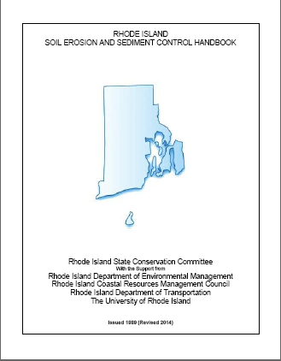
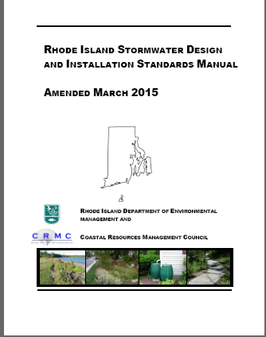
Soil Erosion and Sediment Control
Performance Criteria Are Now Aligned
Part D – SESC Plans
Minimum Standard 10 - SESC
Notes:
Minimum Standard 10 of the RISDISM is being revised to be consistent with the Performance Criteria established for Soil Erosion and Sedimentation Control Measures contained in the 2013 RIPDES Construction GP and the 2014 RI SESC Handbook.
In August of 2014 the Rhode Island State Conservation Committee (RISCC) adopted the new RI SESC Handbook. The RISCC established a Technical Review Committee that met from 2012 to 2014 and implemented a Peer Review process to develop the updates.The updates included the incorporation of Performance Criteria for SESC Measures that were consistent with the EPA C&D Rule and the RIPDES Construction GP (Part D). The updated Handbook was made available for a 60-day public review and comment period (March – May 2014) and a Public Workshop was held in April of 2014.

Slide 9
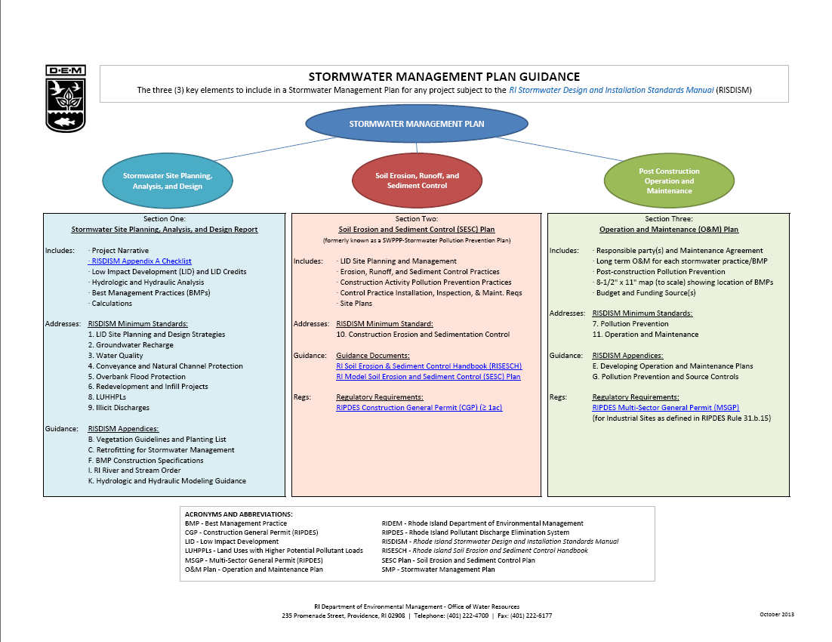

Slide 10
Soil Erosion and Sediment Control Plan Performance Criteria
Brian Lafaille, P.E.
Senior Sanitary Engineer
RIDEM RIPDES Permitting Program

Slide 11
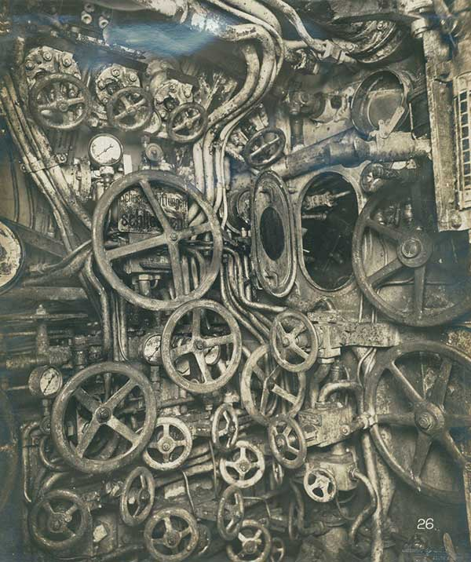
Notes:
Control Room of UB-110 German Submarine (1918)

Slide 12
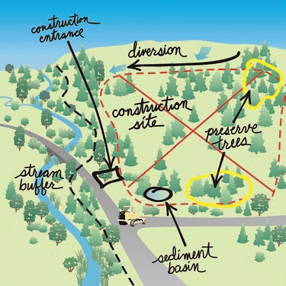
Soil Erosion and Sediment Control Plan

Slide 13
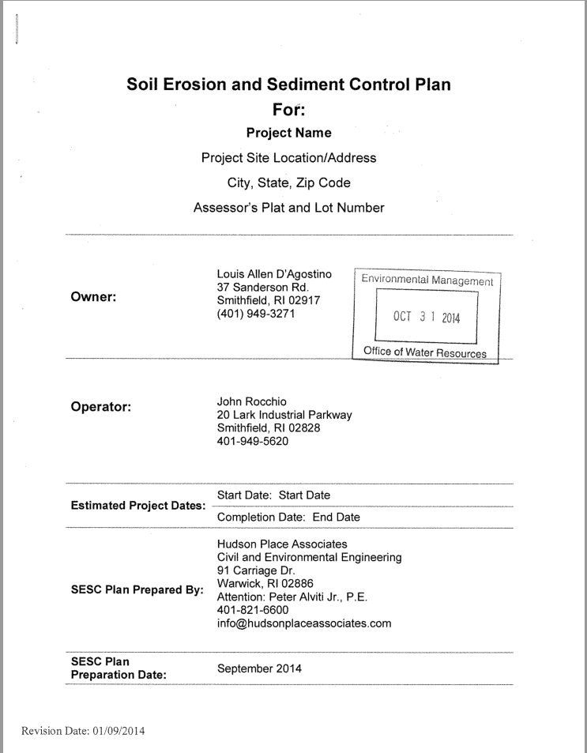
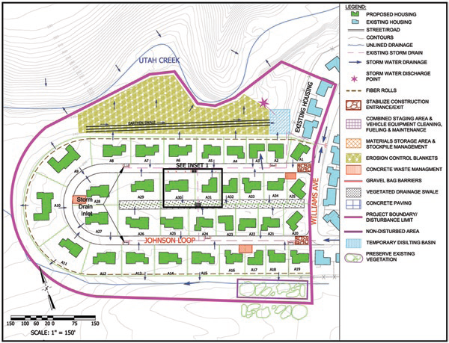
Soil Erosion and Sediment Control Plan
Format
Narrative (Written Document)
Site Plans ( Construction Drawings)

Slide 14
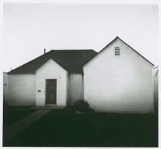

Slide 15
Soil Erosion and Sediment Control
Performance Criteria
Avoid and Protect Sensitive Areas and Natural Features
Minimize Area of Disturbance
Minimize the Disturbance of Steep Slopes
Preserve Topsoil
Stabilize Soils
Protect Storm Drain Inlets
Protect Storm Drain Outlets
Establish Temporary Controls for the Protection of Post-Construction Stormwater Treatment Practices
Establish Perimeter Controls and Sediment Barriers
Divert or Manage Run-on from Up-gradient Areas
Properly Design Construction Stormwater Conveyance Channels
Retain Sediment Onsite
Control Temporary Increases in Stormwater Velocity, Volume, and Peak Flows
Construction Activity Pollution Prevention Control Measures
Control Measure Installation, Inspections, Maintenance, and Corrective Actions

Slide 16
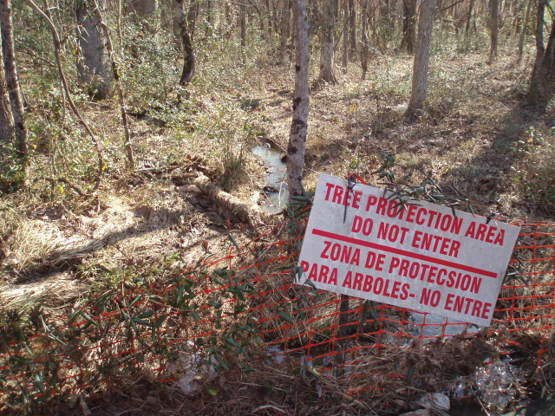
Avoid and Protect Sensitive Areas and
Natural Features
Example signage and fencing protecting wetland buffers and forest. Source: RI LID Site Planning and Design Guidance Manual

Slide 17
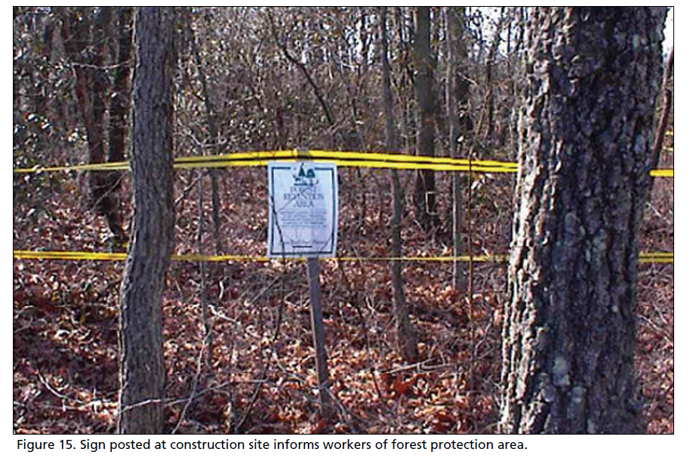
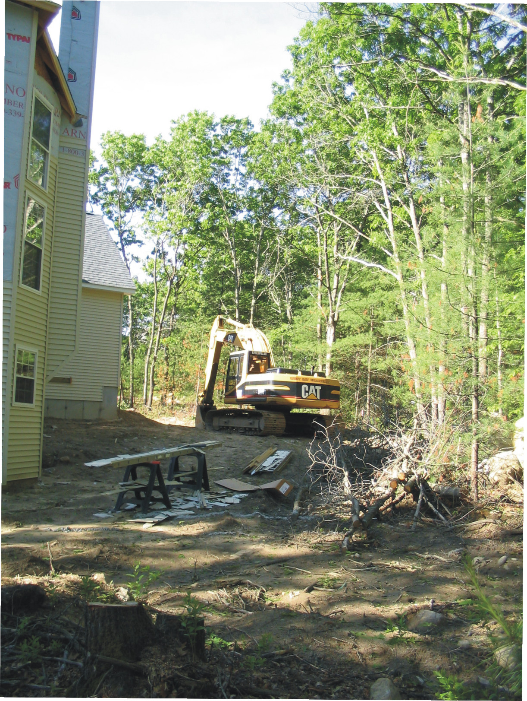
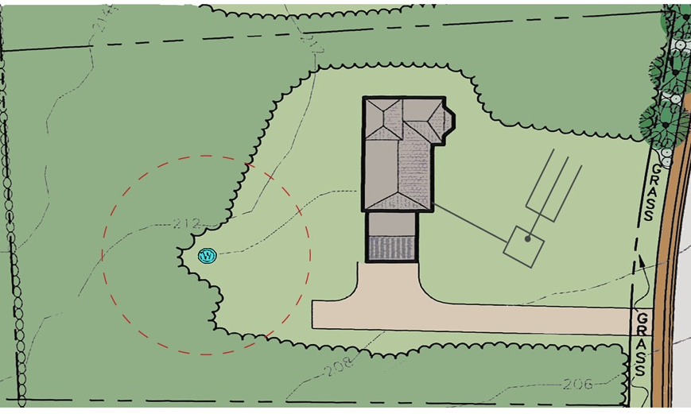
Minimize Area of Disturbance
~ 20 ft

Slide 18
Minimize Disturbance of Steep Slopes

Slide 19
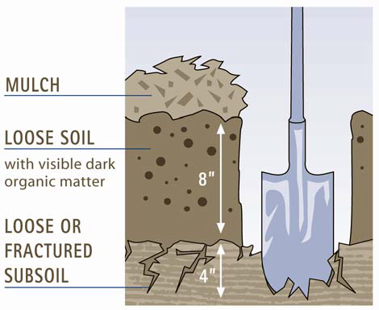
Preserve Topsoil
4 -

Slide 20
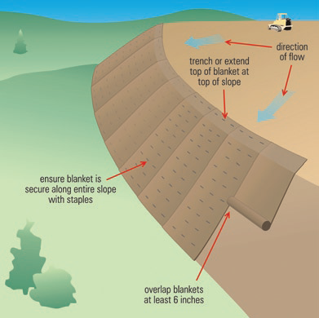
Stabilize Soils

Slide 21
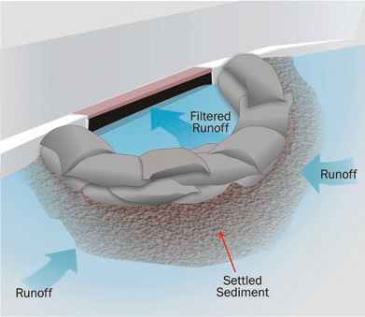
Protect Storm Drain Inlets

Slide 22
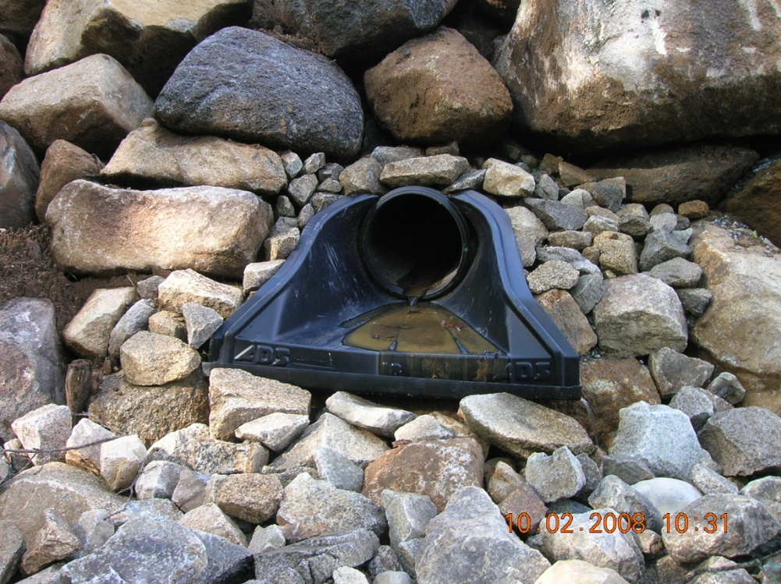
Protect Storm Drain Outlets

Slide 23
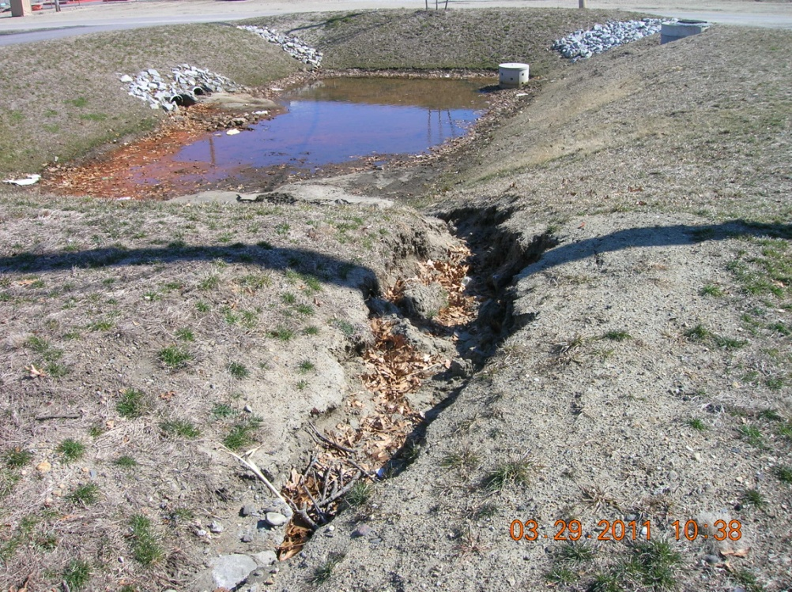
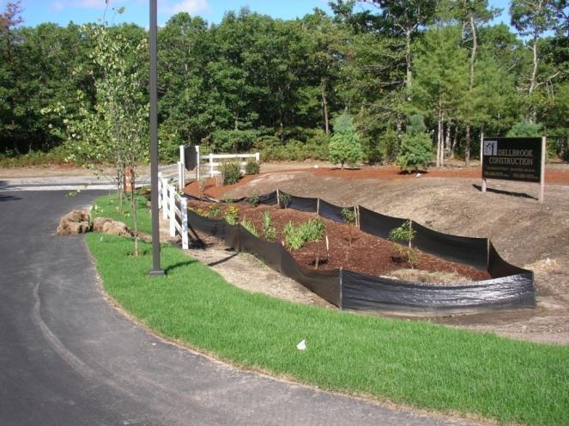
Establish Temporary Controls for the Protection of Post-Construction Stormwater Treatment Practices

Slide 24
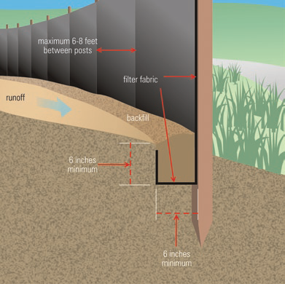
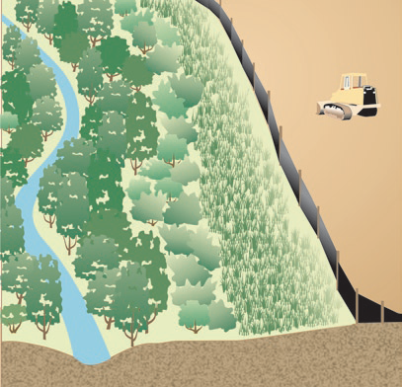
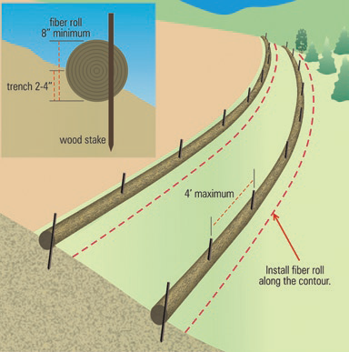
Establish Perimeter Controls and Sediment Barriers

Slide 25
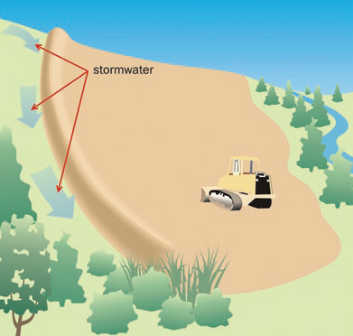
Divert or Manage Run-on from Up-gradient Areas
Source: USEPA-833-R-06-004 May 2007

Slide 26
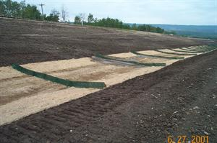
Properly Design Construction Stormwater Conveyance Channels
Temporary Conveyance Channels must be designed to handle the 10 Year, 24 Hour Type III Design Storm

Slide 27
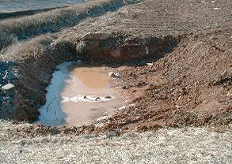
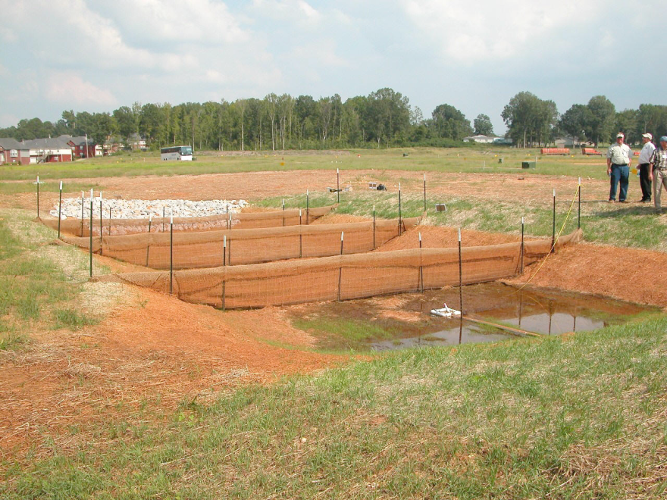
Retain Sediment Onsite
Temporary Sediment Trap
Temporary Sediment Basin
  Sediment Traps are Mandatory for Common Drainage Locations Where 1-5 Acres of Land Will Be Disturbed
  Sediment Basins are Mandatory for Common Drainage Locations Where >5 Acres of Land Will Be Disturbed

Slide 28
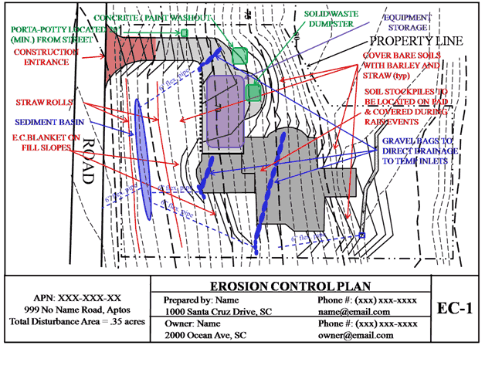
Control Temporary Increases in Stormwater Velocity, Volume, and Peak Flows
Goal: Protect Downstream Receiving Waters, Conveyances, and Drainage Systems During Construction.
In most cases the combination of all other performance criteria will be adequate.
SESC Plan Preparer must evaluate the need for additional velocity, peak, and volume controls.
Notes:
Goal: protect downstream receiving waters, Protect receiving conveyances and drainage systems
Part D.C.3. – “In most cases the combination of measures will be adequate to control temporary increases in velocities, volumes and peak flows.” examples of when it wouldn’t apply??
Designers responsibility to evaluate if additional velocity, peak and volume controls are necessary
For any area >5 acres disturbed at one time the reviewing authority may require additional peak controls.
Construction Sequencing, Phasing, Maintaining existing Vegetation, Re-establishing Vegetation
Designer must evaluate if the 10 yr storm (10 hour residence) is adequate or larger storms must be controlled.

Slide 29
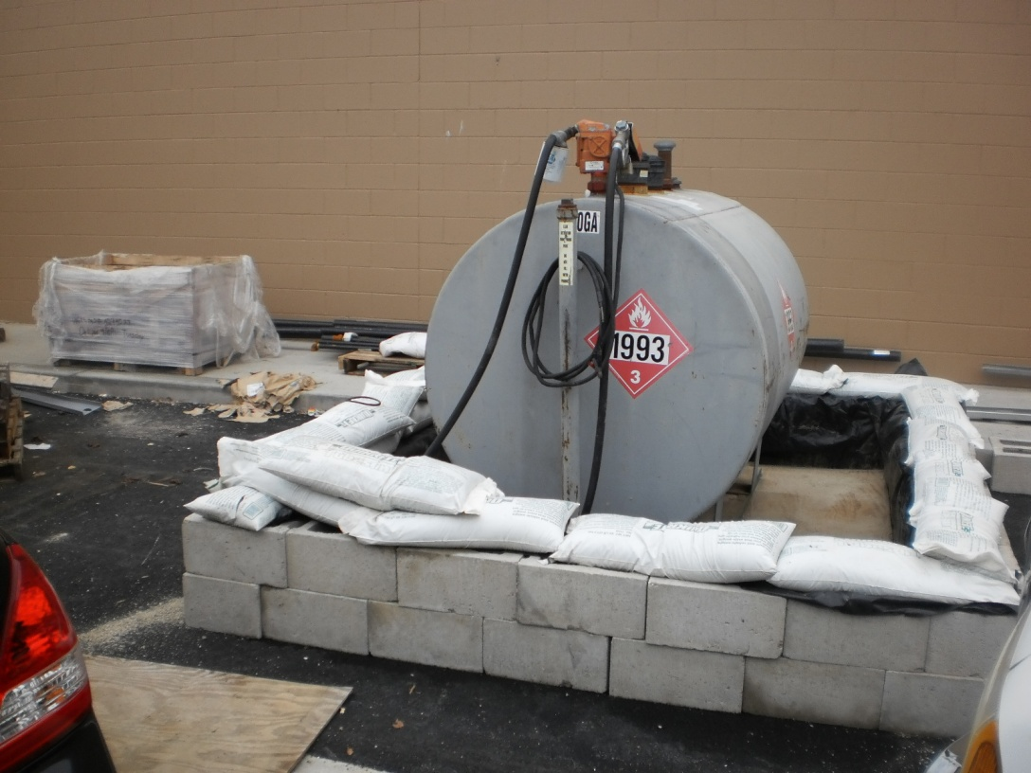
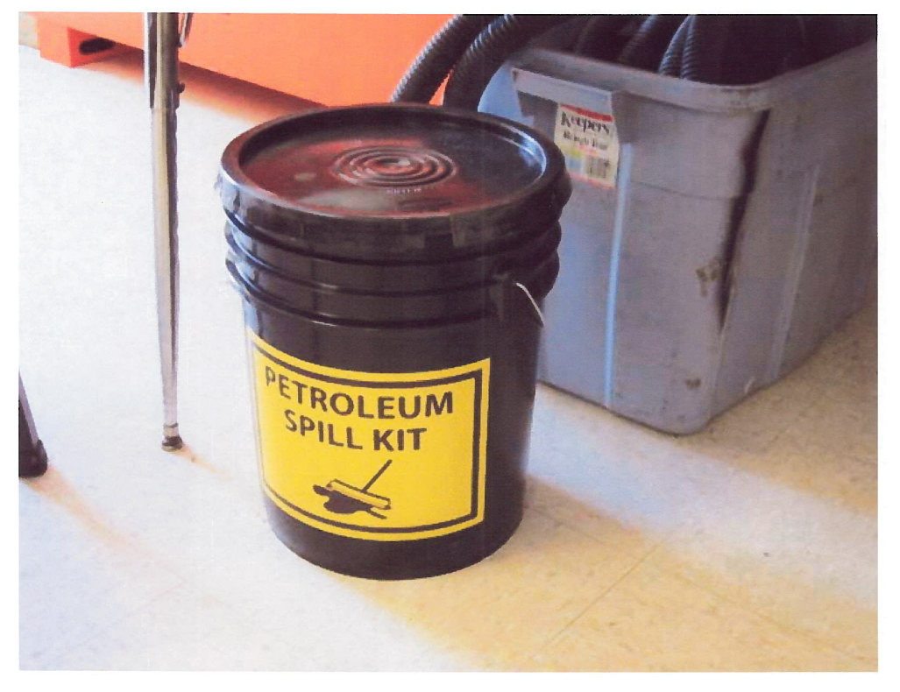
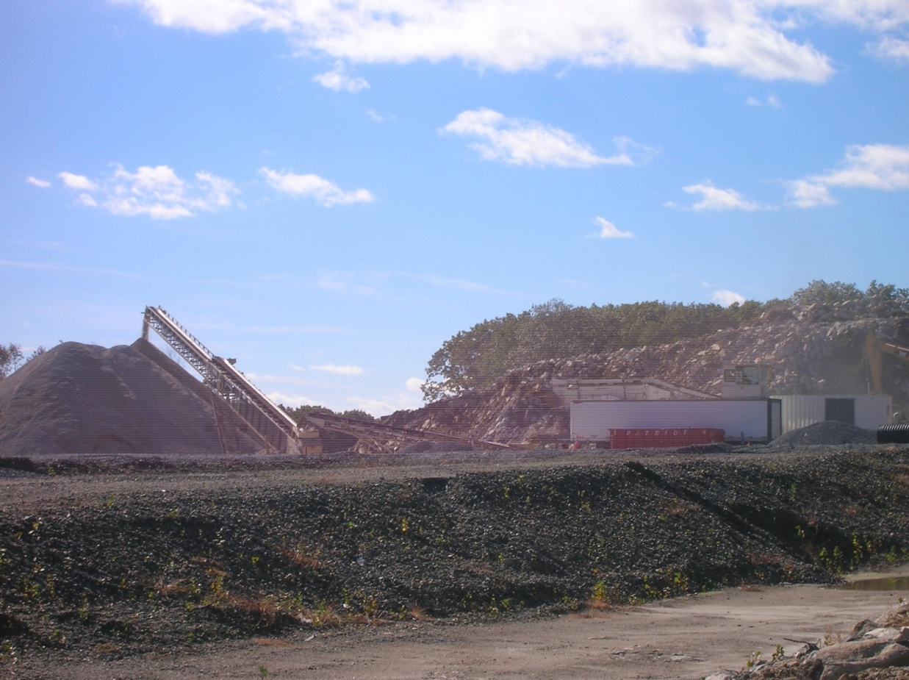
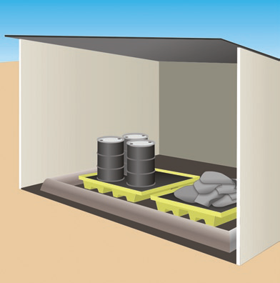
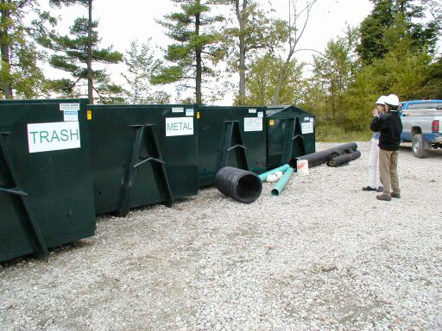
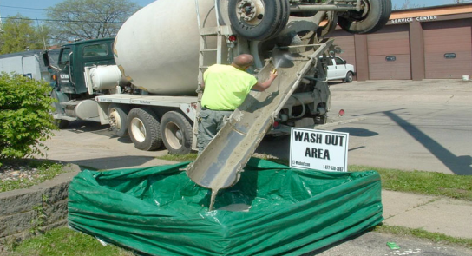
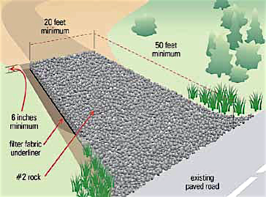
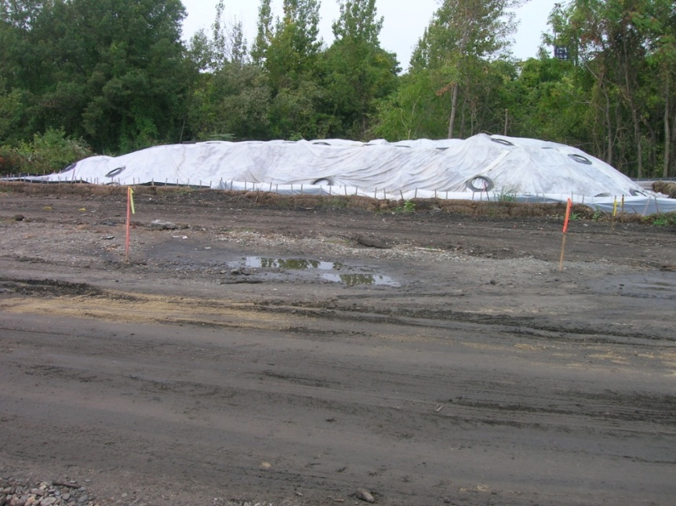
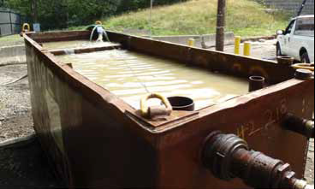
Construction Activity Pollution Prevention Control Measures

Slide 30
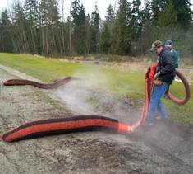

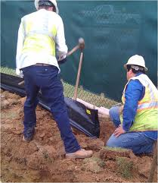

Control Measure Installation, Inspections, Maintenance, and Corrective Actions

Slide 31
Questions?

